Slide 1

Vault Banking
Using AES in an Android Banking Application
April 20th, 2018
MSCS 630

Slide 2
Application Goals
Simulate a banking application.
Encrypts user’s password and email together to create an authentication key.
Uses the user’s authentication key at login to grant access to account information.
The ability to register a new user (generates random keys at account creation).
The ability to view account information.
Uses AES to generate new authentication keys during password recovery.

Slide 3
Kotlin
The primary language used to code this app was Kotlin:
The official language of Android Development.
Runs on the JVM.
Outputs Java bytecode.
Functional programming.
Object-oriented Programming.
Aggressive type inference.
Statically typed.
Interoperable with Java code.
A less verbose flavor of Java.

Slide 4
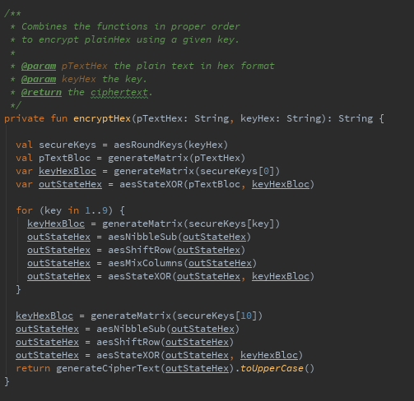
Kotlin
Example of Kotlin’s static
type inference.

Slide 5
Firebase
The database used for this Android application is a NoSQL database offered by Google’s web application Firebase.
Firebase offers a large range of services:
Analytics
Authentication
Cloud messaging
Realtime database
Plus many others
Integrates with Android, iOS, JavaScript, Java, Objective-C, Swift, and Node.js.
Realtime Database

Slide 6
First Ring of Security
The strength of this authentication scheme is that the password is not stored within the NoSQL database. To authenticate to the system you must know the email and password. The authentication key is created by encrypting the plaintext with the user's key. The plaintext is the formatted email appended with the formatted password with a delimiter character ':' in between.
Email/Password knowledge.

Slide 7
Second Ring of Security
The second ring of security being used is AES-ECB at 128 bits. The key generated from user credentials would take 1.02 x 10^18 years to crack with a supercomputer using brute force.
However, ECB mode is weak in that it will always produce the same ciphertext when using the same key. A solution to this would be to implement CBC or GCM mode. Another solution could be to change the secret key and generate a new authentication key on every successful login.
Advanced Encryption Standard

Slide 8
Third Ring of Security
HTTPS (Hypertext Transfer Protocol Secure) is much more secure than HTTP. HTTPS encrypts the data sent between your device and the website you are connected to. HTTPS does not mean your information is safe after arrival, only in transit.
HTTPS uses the cryptographic protocols TLS (Transport Layer Security) and SSL (Secure Sockets Layer) to
HTTPS

Slide 9
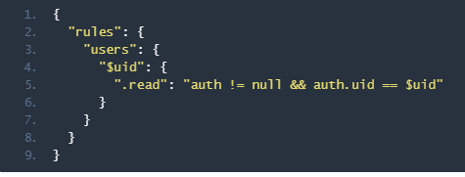
Fourth Ring of Security
Firebase offers the ability to set rules in place for data to be read, write, and/or validated.
Firebase Security and ruleset

Slide 10
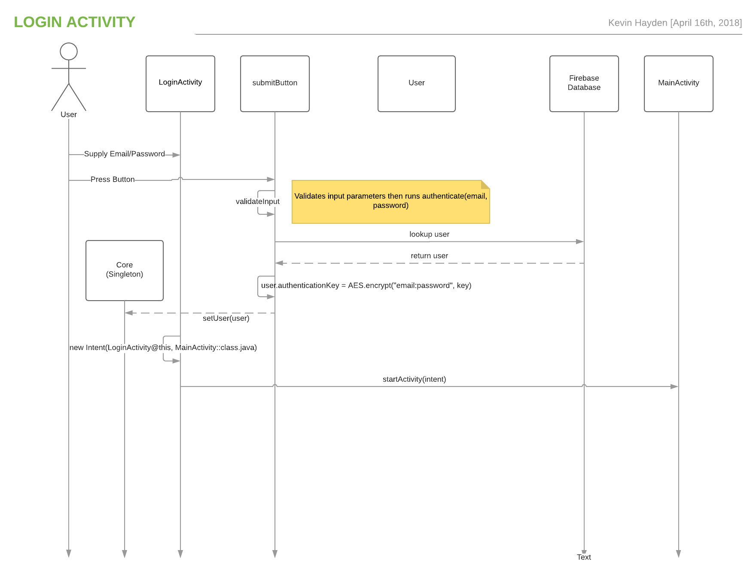
Login Activity
Use case diagram

Slide 11
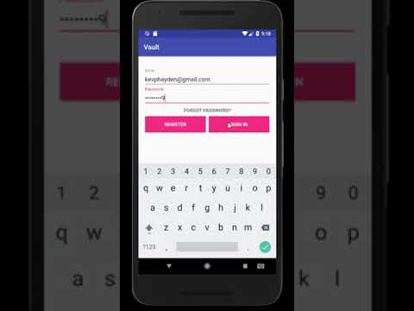
Login Activity
Presentation of the login
process.

Slide 12
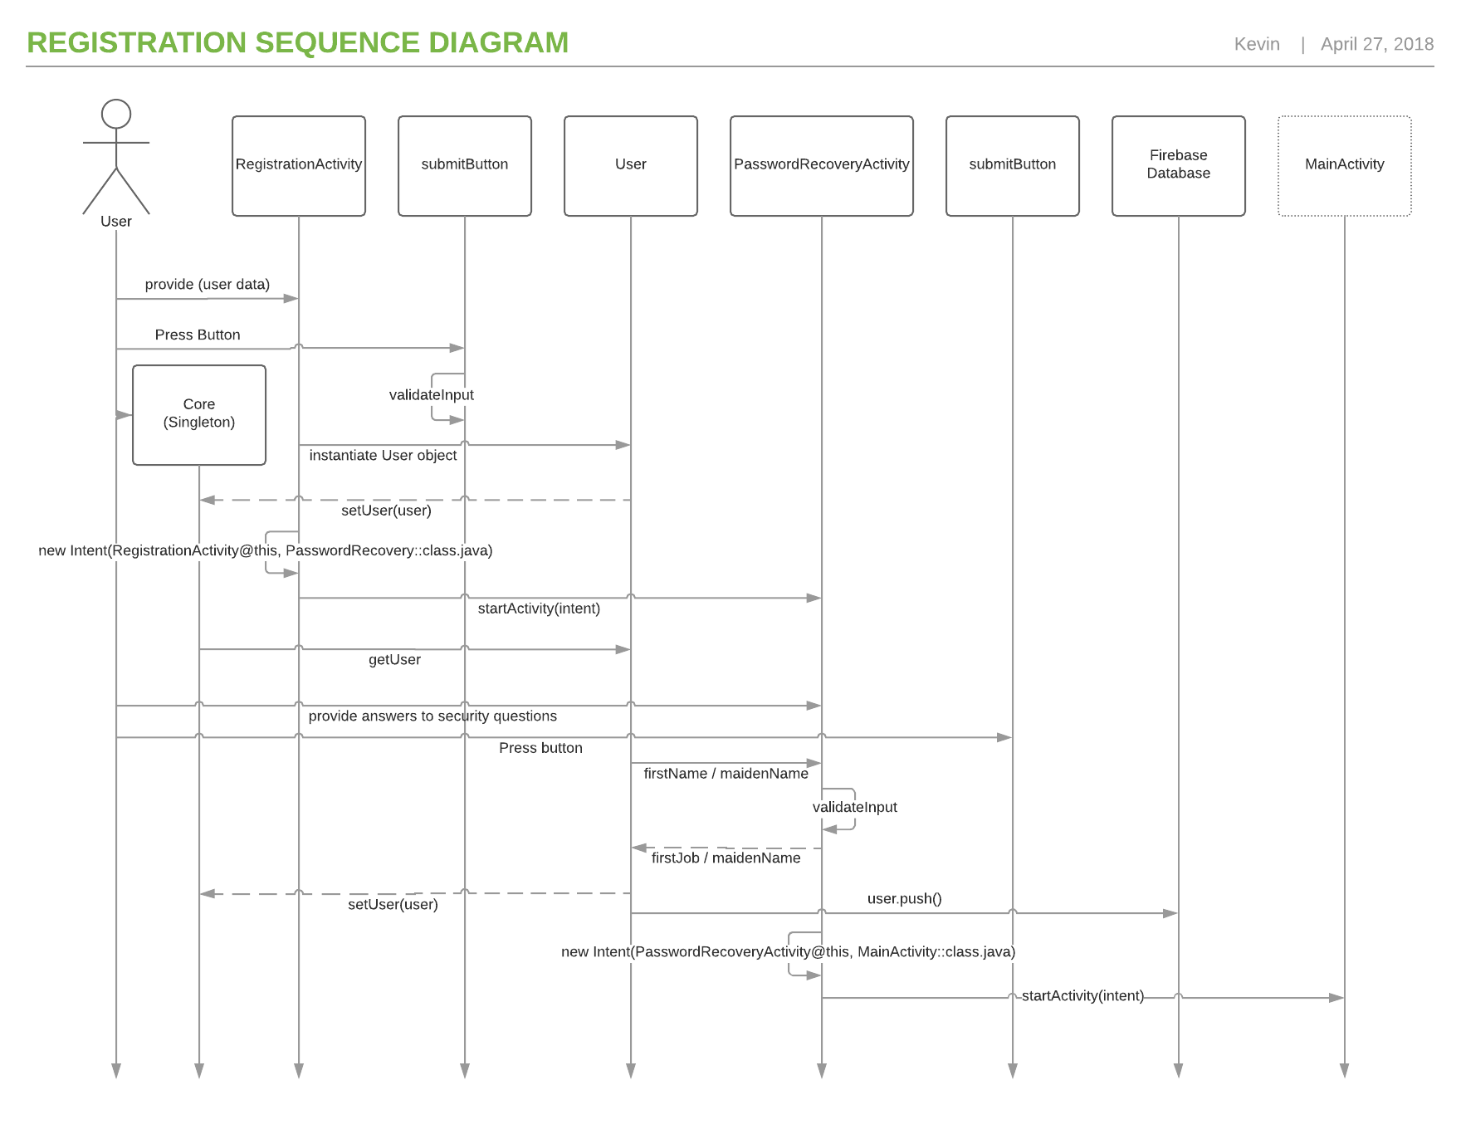
Registration
Activity

Slide 13
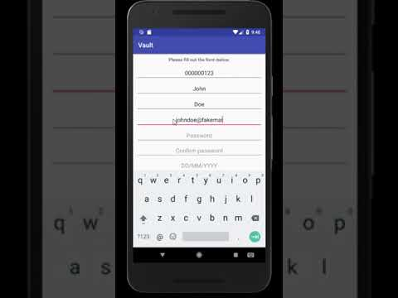
Register Activity
Presentation of the registration
process.

Slide 14
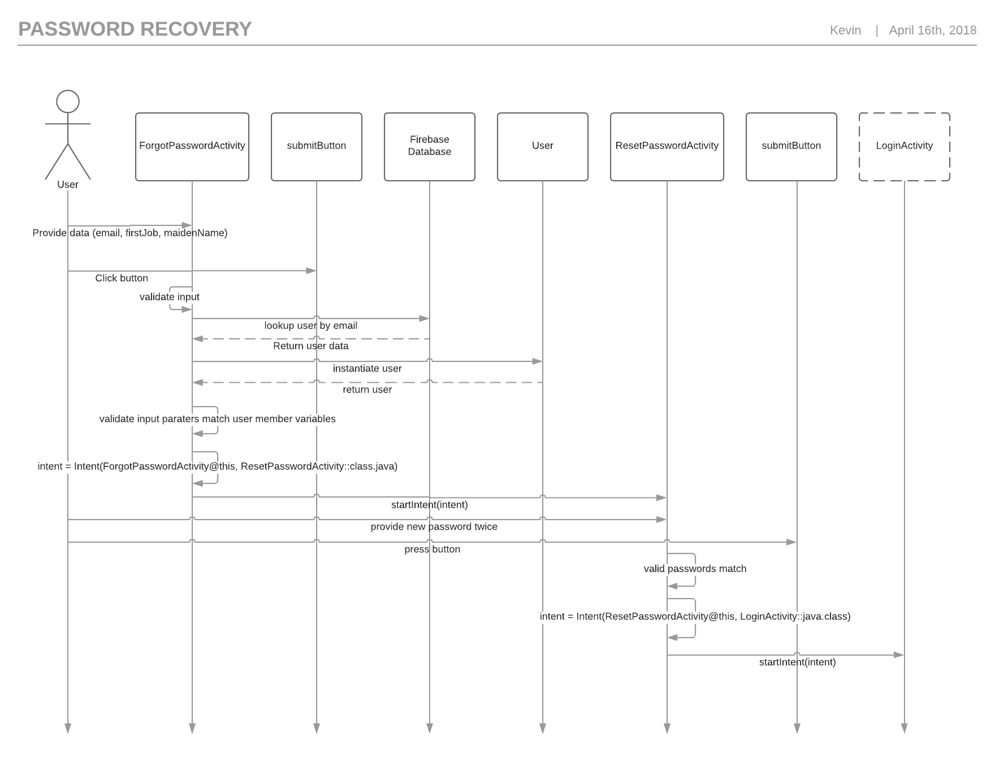
Password
Recovery
Activity
Presentation of the
password recovery
process.

Slide 15
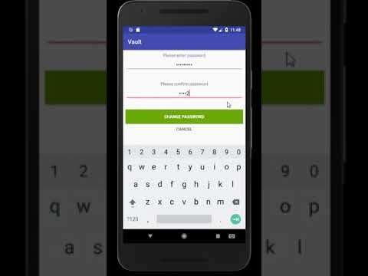
Password
Recovery
Activity
Presentation of the password
Recovery process.

Slide 16
Points/features to explore
2-Step Authentication for Login.
Email authentication for Registration.
Email authentication for Password Recovery.
Account lock threshold for a certain amount of failed password attempts.
Transactions data class.
Encrypting the answers to the security questions at rest in Firebase.
Activity for viewing transactions.
Transferring money to and from accounts.
Loading widgets/screens for data query.
Ideally, account registration would happen at bank branch.
Using Firebase rules to set read/write privileges.

